Slide 1
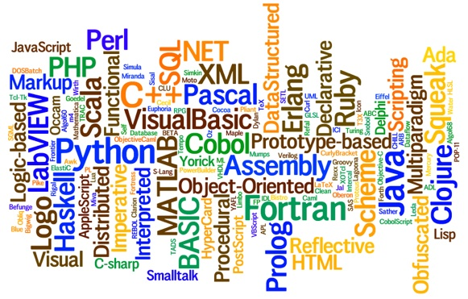
CS-445 Programming Languages Slides 2 – Classification of Programming Languages
By Talha Waheed, UET Lahore

Slide 2
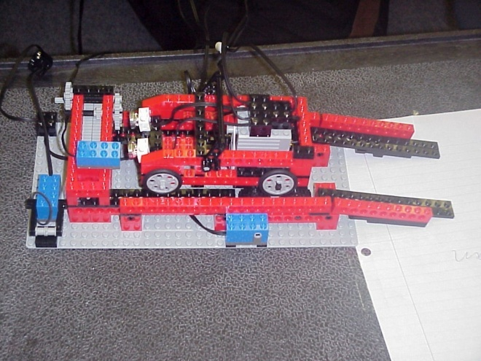
Typical classifications of PL
Low-level vs. High-level vs. Very High Level
Language generations
1st , 2nd , 3rd , 4th, 5th ...
e.g. machine, assembly, procedural, application, AI techniques & inference languages, neural nets
General-purpose vs. special purpose
C/C++, Scripting Languages, Robot Programming Language
Different Language Implementation
Language Paradigms

Slide 3
Communicating with Computers
Non-Tech Definition of a PL
a way of communicating with the computer to tell it what it should do.
Challenge for half a century
ENIAC to present
Approaches to communicating with computers
Driven by applications and their properties
Also by computers and their properties
But a "modern" approach should minimize this
Still arguments based on "performance"
But with 500 M operations per second available and doubling every couple of years
Performance can no longer be the dominant issue!
Notes:
What is a Natural Language?

Slide 4
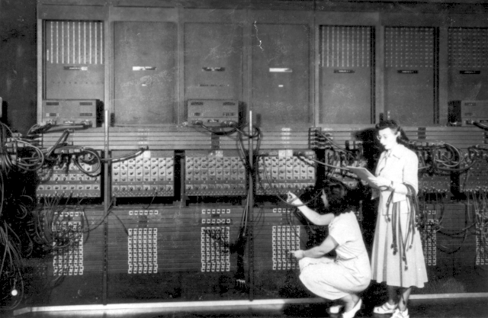
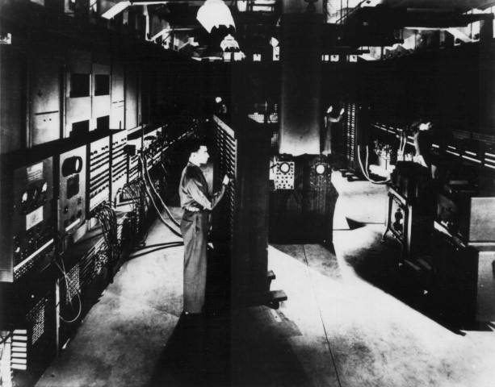

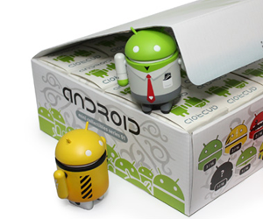

ENIAC To Present
Ruby on Rails
Mobile Development
Machine Learning

Slide 5
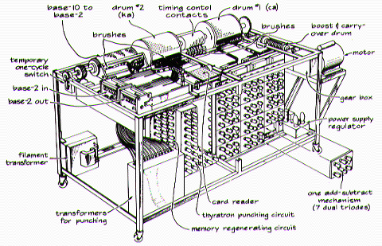
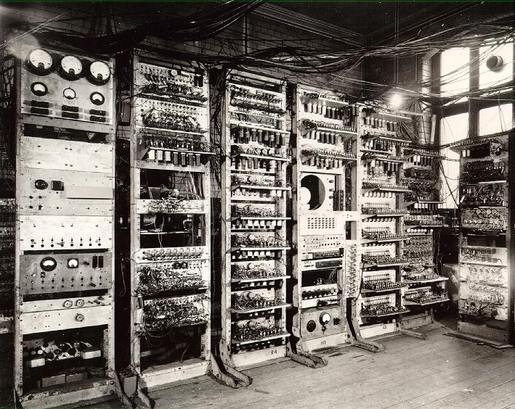
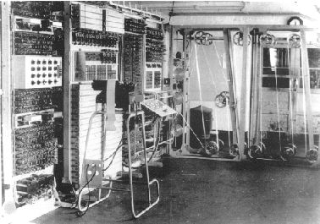
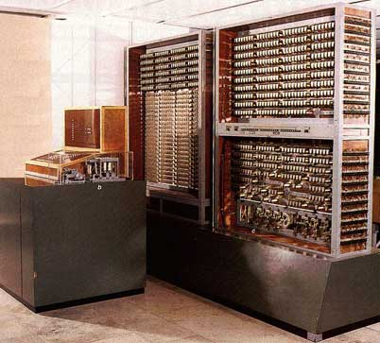
First Generation of Computers

Slide 6
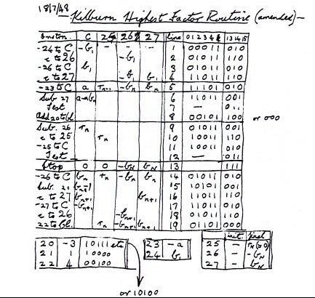
Evolution of Communicating with Computers
Communicating at all by
Cables, Binary, ASSEMBLY LANGUAGE
Communicating math (formulas)
FORTRAN
Communicating business math
To non-mathematicians
COBOL
Communicating algorithms
ALGOL
Simulation
SIMULA
First Ever Computer Program??

Slide 7
1st Generations of Languages ­- Machine Languages
An example code (von Neumann machine, 1946) for the program Add numbers in locations 10 and 11 and store result in location 12: 00000010101111001010 00000010111111001000 00000011001110101000
Operations are specified in terms of actual numeric code.
Operand are specified in terms of their absolute address in memory or as a register number.
Everything is encoded as a sequence of 0s and 1s.
As a result, programming requires deep knowledge of underlying machine architecture and programs become unintelligible!

Slide 8
1st Generations of Languages ­- Assembly Languages
To make programs more intelligible, each operation and operand is specified using a symbolic name e.g., load, add, store
Assembler turns assembly code into machine code.
Can have macros as shorthand for sequences of code (macro assembler).
Still Machine­ dependent, i.e., features depend on hardware.
Hard to read and to port to other machines.
Programming is similar to programming in machine languages, though somewhat less difficult.

Slide 9
Generations of Languages -­ High­ Level Languages
Today's conventional languages (C, C++, Java, Lisp, COBOL).
Higher ­level constructs such as
if and while statements, procedures, etc.
much easier to write and read
supporting consistency checks which help detect bugs
preprogrammed libraries (reusability)
machine­ independent, though still sometimes implementation­ dependent
portable
The programmer specifies instructions that a language processor understands and translates or executes.
Notes:
Before the first Fortran compiler (1957), it was commonly believed that any compiler would produce code so terribly inefficient as to be useless.

Slide 10
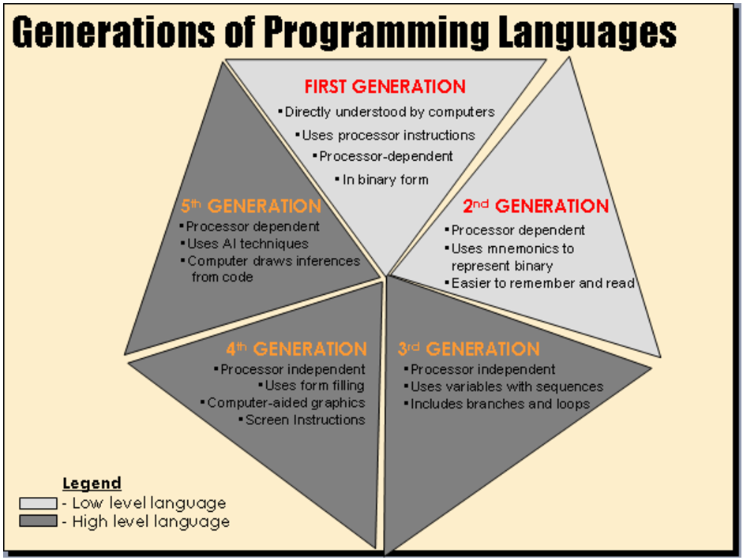

Slide 11
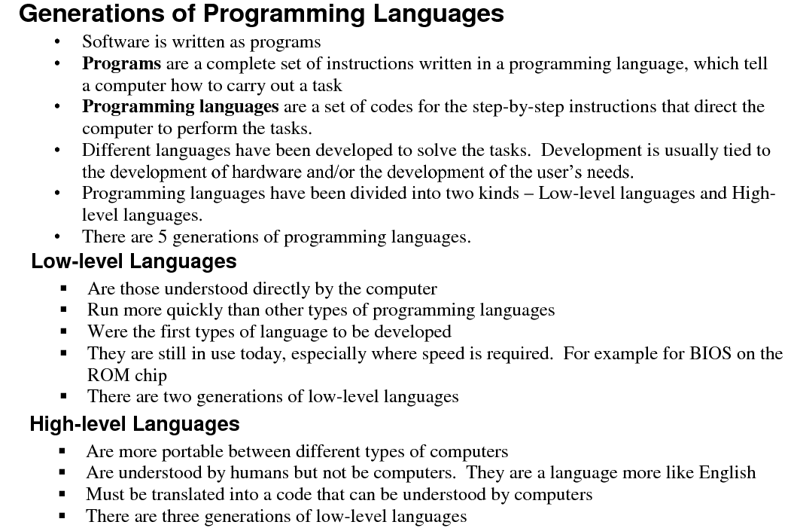

Slide 12
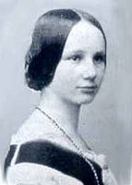
History of Language Development
1950s - Exploiting Machine Power
Machine Language, Assembly Languages, FORTRAN
1960s - Increasing Expressive Power
COBOL, Lisp, Algol 60, BASIC, SNOBOL, PL/I, Simula
1970s - Portability and Reliability
Pascal, Algol 68, C
1980s - Managing Complexity
Modula-2, Ada, Smalltalk, Eiffel, ML
1990s - Parallelism, Distribution, Objects
C++, Modula-3, Ada 95, . . . JAVA!!!, XML
2000s - ????
C#, Ruby, What Next ???

Slide 13
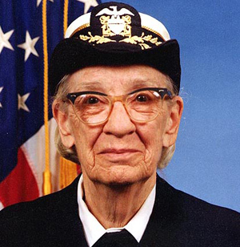
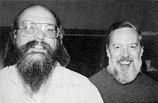
History: mid-1950s to early 1970s (1/2)
Main areas of application
numerical computation
1957-FORTRAN
1958-Algol
business
1955-FLOWMATIC (Grace Hopper)
1959-COBOL
artificial intelligence
about 1955-IPL, IPL-2, IPL-V (Newell, Shaw, Simon)
Fall 1958-Lisp (McCarthy)
for string processing: COMIT, SNOBOL4
systems programming
CPL, BCPL
1972-C

Slide 14
History: mid-1950s to early 1970s (2/2)
Hardware: main frames running batch processes
mostly file processing, punched cards
error recovery and exception handling to reduce need for reruns
no timing constraints on programs

Slide 15
History: 1970s to 1980s
Hardware: time sharing main frames
time sharing --- "an idea whose time has come and gone"
interactive computing; keyboard input
I/O properties of keyboards different from files
error recovery by interaction with user
timing constraints (computer response time, user pauses)

Slide 16
History: 1980s to 1990s
Hardware: PCs, micro-controllers, and embedded systems
Time sharing not needed (but reemerges to provide multiprocessing)
interactive graphics is important
micro-controllers and embedded systems operate without OS or use special real-time OS
embedded systems must be reliable and correct; need to operate in real time, recover from errors, ordinarily never terminate, are often distributed systems

Slide 17
History: 1990s to present
Hardware: the world is one big computer (Internet)
distributed computing is everywhere on local area networks, the internet
reemergence of central computers (servers)
security becomes even more important than before
making programs run on multiple platforms becomes an issue
New applications
(desktop) publishing: TEX, Postscript
software agents and other processes, including scripts

Slide 18
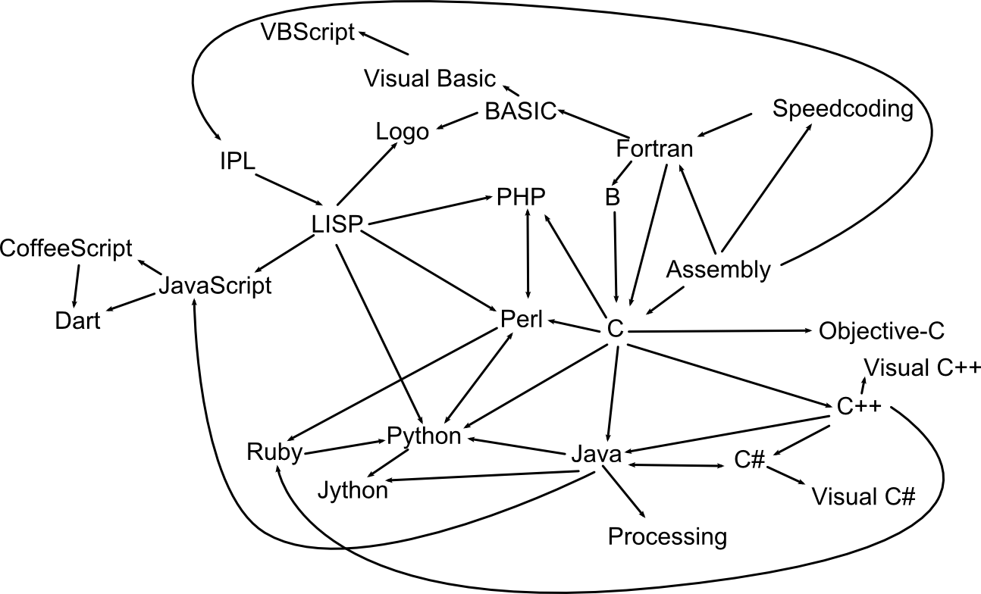
A Simplified Family Tree of Programming Languages

Slide 19
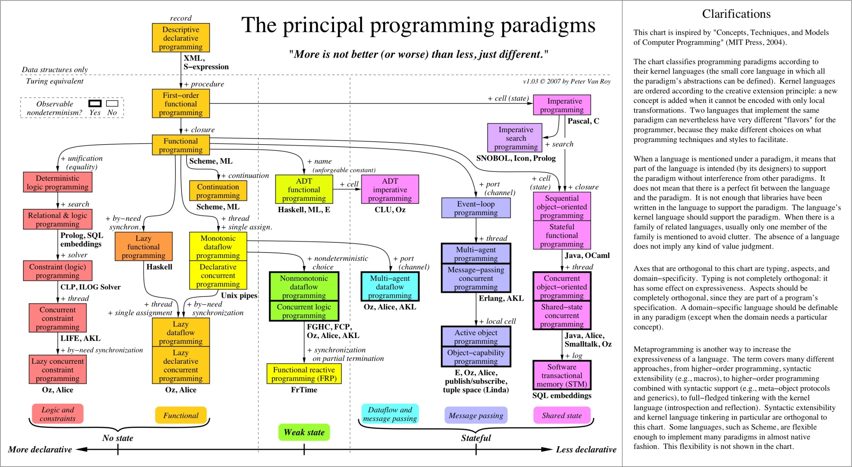

Slide 20
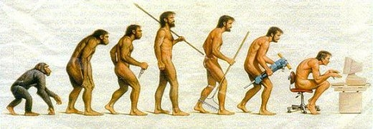
The Evolution of Human

Slide 21
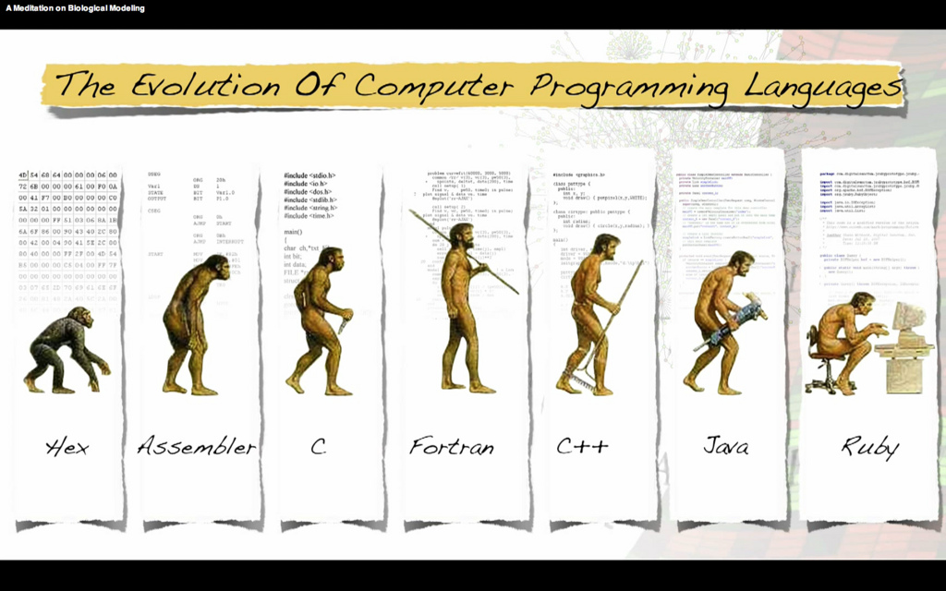

Slide 22
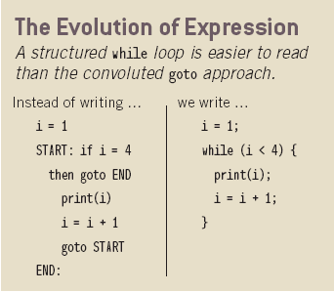
Factors Influencing Language Design
The language we "speak" influences what we can say
[Whorf]
Application programmers' perspective
Make programming as easy and natural as possible
Define a user-friendly "virtual machine“
Language implementers' perspective
Make efficient implementation possible
Define a reasonable mapping to a real machine

Slide 23
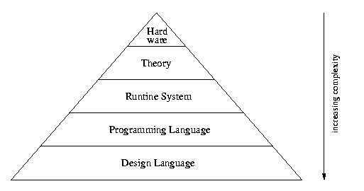
Factors Influencing Language Design
Hardware Architecture
Application Domains
New uses and users, Changing requirements
Programming methodologies
Managing large, complex systems
Implementation methods
Improved techniques
Theoretical studies
Assess strengths and weaknesses
Standardization (formal or de facto)
Portability & Re-use
Strong promoter (usually an organization)
Easy access to high quality compilers and tools
Hardware
Applications
Programming Languages
Systems Software
Theory

Slide 24
Translation
Converting a program written in a HLL into machine language.
Compilation: whole program is translated before execution. (C/C++)
Interpretation: Translate and execute, one statement at a time. (BASIC)
Source Code
Source Code
Input
Output
Compiler
Interpreter
Input
Target Code
Output
Notes:
interpreters run program
translator (compilers) transform programs from one form to another
the CPU is a hardware interpreter; it actually does something
hybrid systems: compile to byte-code, interpret byte-code

Slide 25
Comparison of the two methods
Compilation
Brings the program down to machine level
Can execute translated program many times because the entire translation is produced.
Program execution is much faster because the translator can do optimization.
Harder to provide feedback when debugging because executing the target code.
Interpretation
Brings the machine up to the program level.
Must re­translate for every execution.
Program execution is much slower.
Easier to provide feedback when debugging because executing the source code.

Slide 26
Pseudo­compilation
A hybrid of compilation and interpretation
Source Code
Compiler
Intermediate Code
Input
Output
Interpreter

Slide 27
Pseudo­-compilation
A compiler translates the whole program before execution, but only into intermediate code.
An interpreter translates and executes the intermediate code one statement at a time.
The intermediate code can be executed on any machine that has an interpreter for the intermediate code.
more portability and machine independence
Java initially used this hybrid strategy. (intermediate code: bytecode)

